Slide 1
Neurotrajectory
include the power calculation

Slide 2
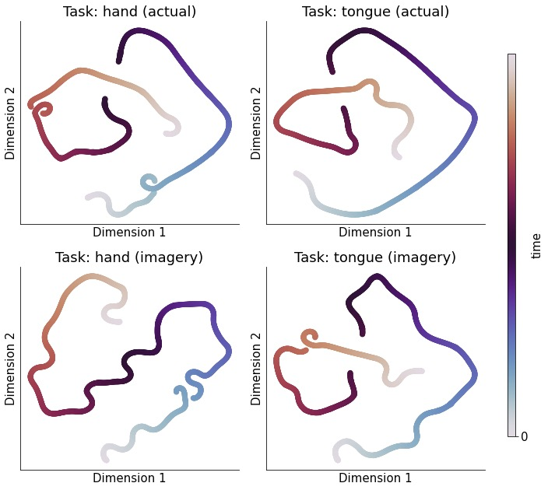
thelta (4-8Hz)

Slide 3
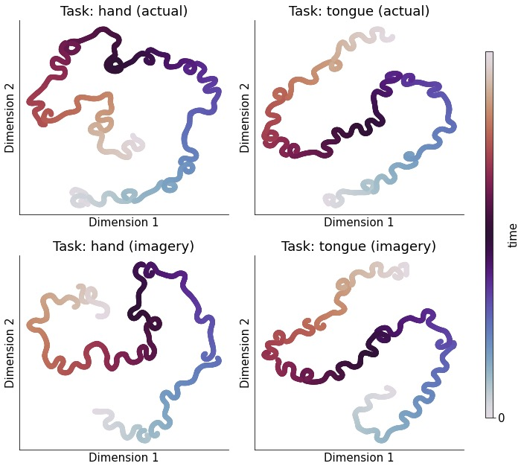
alpha (8-12Hz)

Slide 4
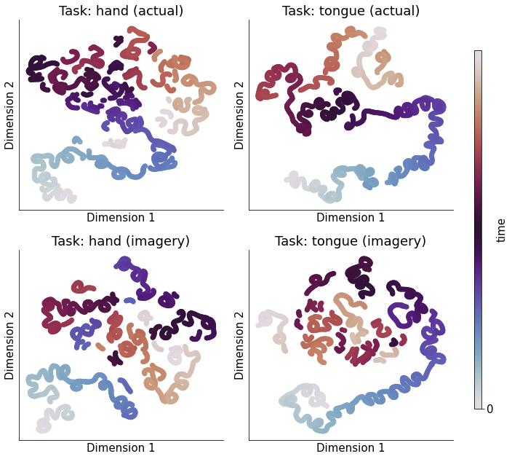
beta (12-35Hz)

Slide 5
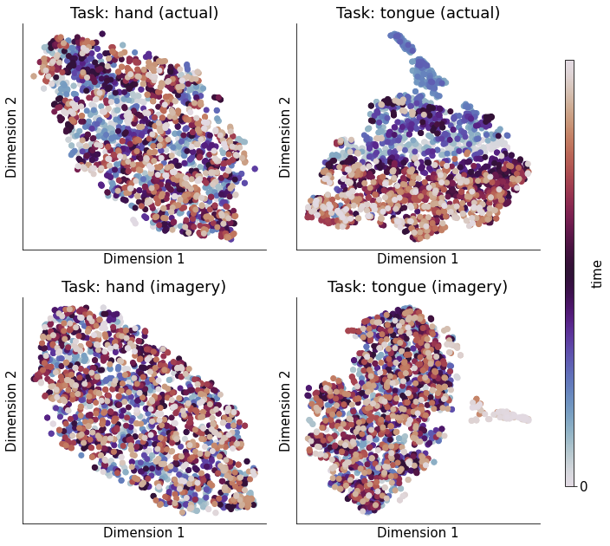
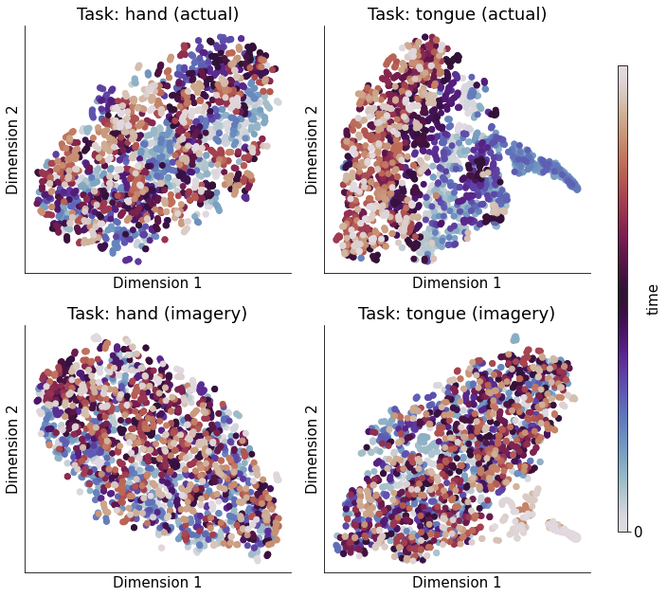
gamma (35-140Hz& 100Hz)
Notes:
https://www.sciencedirect.com/topics/agricultural-and-biological-sciences/brain-waves

Slide 6
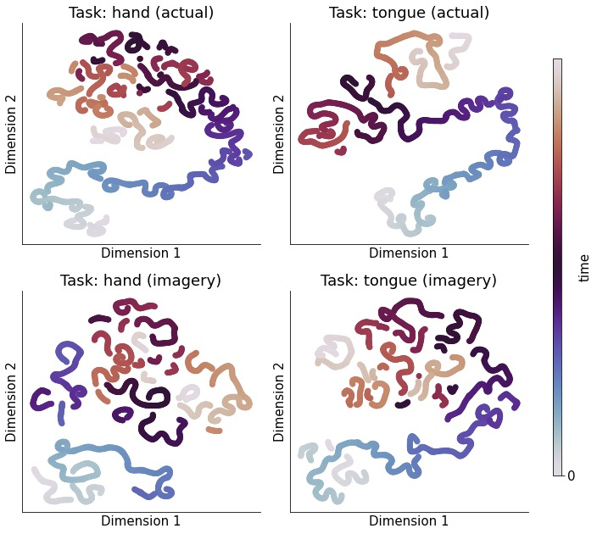
low (8-32Hz)

Slide 7
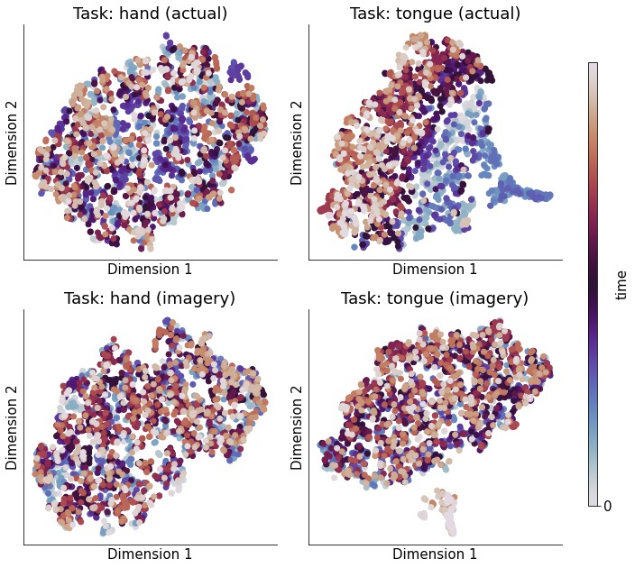
high (76-100Hz)

